Slide 1

Meeting #14. The t-statistic, t-distribution, t-tests, and p-values
Aaron Quinlan
November 4, 2019
bit.ly//sllobs
Notes:
Open up RStudio, you can find the lecture as usual on the github site

Slide 2

The t-test
Applied Computational Genomics
https://github.com/quinlan-lab/applied-computational-genomics
Aaron Quinlan
Departments of Human Genetics and Biomedical Informatics
USTAR Center for Genetic Discovery
University of Utah
quinlanlab.org

Slide 3
In biology, we often use samples to estimate the behavior of the full population (of molecules, cells, individuals). Sampling introduces uncertainty.

Slide 4
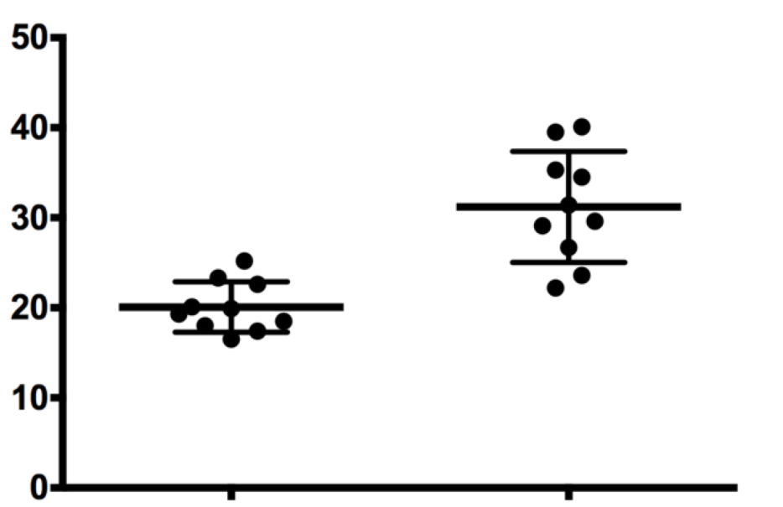
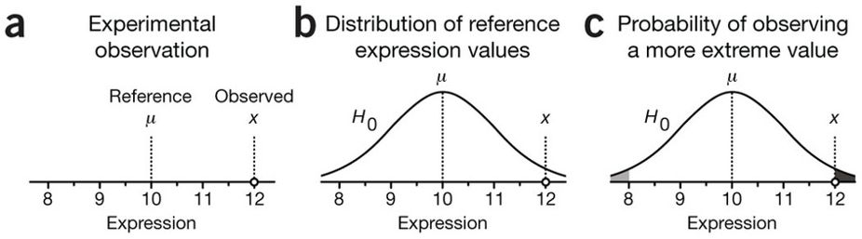
Comparing observations
Two sample t-test
One sample t-test
Measure of interest
Untreated
Treated

Slide 5
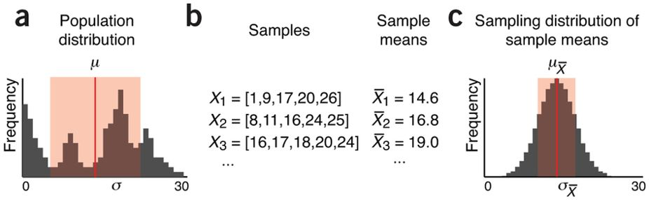
Recall: Central Limit Theorem holds true for any distribution
As the sample size increases, the means of samples will become increasingly close to a normal distribution with a mean (𝞵) equal to the population sample!
https://www.nature.com/articles/nmeth.2613/figures/2

Slide 6
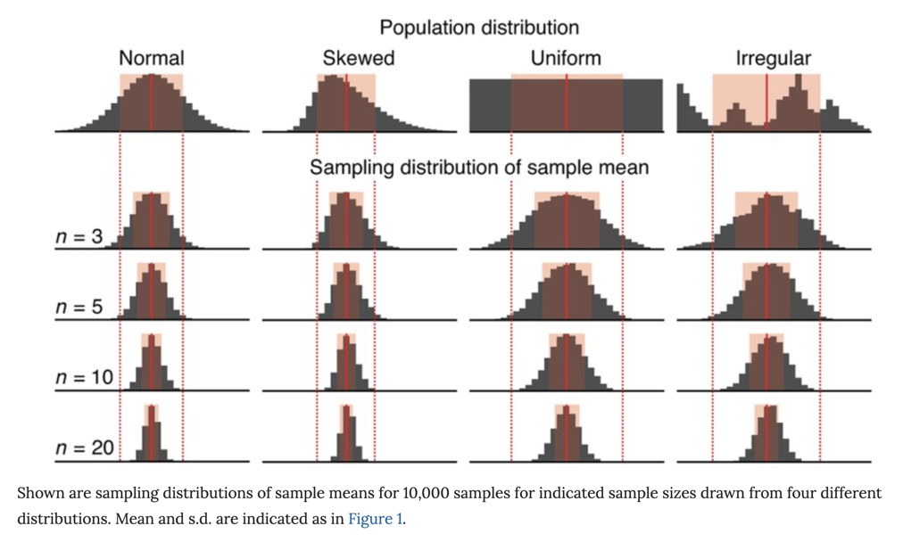
With larger sample sizes (n), the standard deviation of the sample means decreases
Standard deviation of the sample means.
σX̅ = σ/√n
Standard deviation of the
population
As n increases, σX̅ decreases. That is, the samples will have more similar means. Most importantly, when using a larger n, your sample mean is much more likely to be close to the true population mean. This is important in biology because we typically do one sample of size n (i.e., n replicates).
https://www.nature.com/articles/nmeth.2613/figures/3

Slide 7
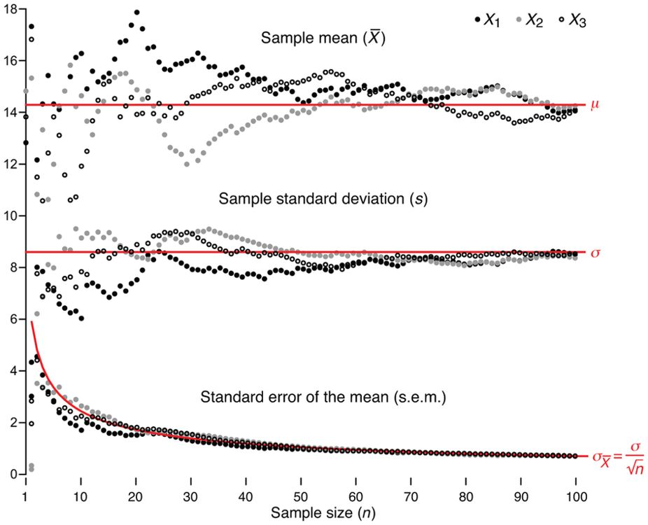
Samples better approximate population as n increases.
The measured spread of sample means is also known as the standard error of the mean (s.e.m., SEX̅, s/) and is used to estimate σX̅, which we cannot know because we cannot collect all possible samples.
The s.e.m. (s/√n) measures how well the sample mean approximates the population mean.
A sample size of 30 is often recommended.

Slide 8
Is our observed value significantly different than a reference value?
?
Is this observed difference compared to the reference value due to random chance?
Assume that technical factors can lead to random fluctuations that disperse measurements forming the null distribution, which encapsulates the null hypothesis (H₀). We assume that the null distribution is normally distributed.
Statistical tests locate an observation on a null distribution to measure the degree to which it is an outlier. In other words, what is the probability of sampling another observation from the null distribution that is as far away from 𝜇? This probability is the P-value
https://www.nature.com/articles/nmeth.2698/figures/1

Slide 9
P-values from two-tailed versus one-tailed tests
Two tailed test: what is the probability of measuring a value at least as far as x from 𝜇? That is, the gray and the black areas under the null distribution
One tailed test: what is the probability of measuring a value greater than x? That is, only the black area under the null distribution
https://www.nature.com/articles/nmeth.2698/figures/1

Slide 10
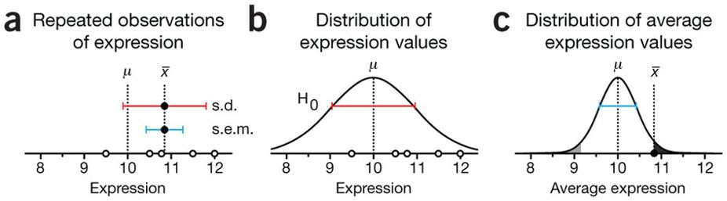
But we need to control for the noise in our measurement!
We assume the reference value (that is, the population mean, 𝜇=10) comes from many precise estimates and is correct. We need to know the "noise" in our measurement of protein expression to assess whether our observed expression value (x=12) is expected under the null. We therefore estimate the spread of our measurement with repeated measurements.
We assume that our sample standard deviation is representative of the standard deviation of the null distribution, even if our sample mean is not. This assumption of "equal variances" is commonly used.
As we learned from the Central Limit Theorem, since the null distribution is normal, we know the the sampling distribution of means will also be normal. Therefore, we can use the s.e.m. to estimate the s.d. on the null distribution of the sample means. We then locate the average expression on this revised null to compute a p-value.
obs_exp = c(12.0,11.5,9.5,10.5,10.8)
mean(obs_exp)
[1] 10.86
sd(obs_exp) # s.d.
[1] 0.9607289
sd(obs_exp)/sqrt(length(obs_exp)) # s.e.m
[1] 0.429651

Slide 11
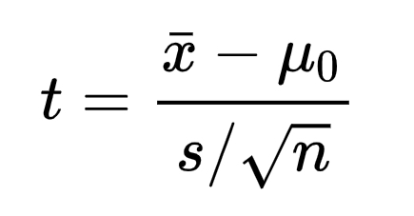
The test statistic (t) measures "signal" versus "noise"
"signal"
"Noise" (s.e.m.)
As we learned from the Central Limit Theorem, since the null distribution is normal, we know the the sampling distribution of means will also be normal. Therefore, we can use the s.e.m. to estimate the s.d. on the null distribution of the sample means. We then locate the average expression on this revised null to compute a p-value.
obs_exp = c(12.0,11.5,9.5,10.5,10.8)
xhat = mean(obs_exp) # xhat
[1] 10.86
s = sd(obs_exp) # s.d.
[1] 0.9607289
sem = sd(obs_exp)/sqrt(length(obs_exp)) # s.e.m
[1] 0.429651
tstat = (xhat - 10.0)/sem # u, the reference value is 10
[1] 2.001624
https://www.nature.com/articles/nmeth.2613/figures/3

Slide 12
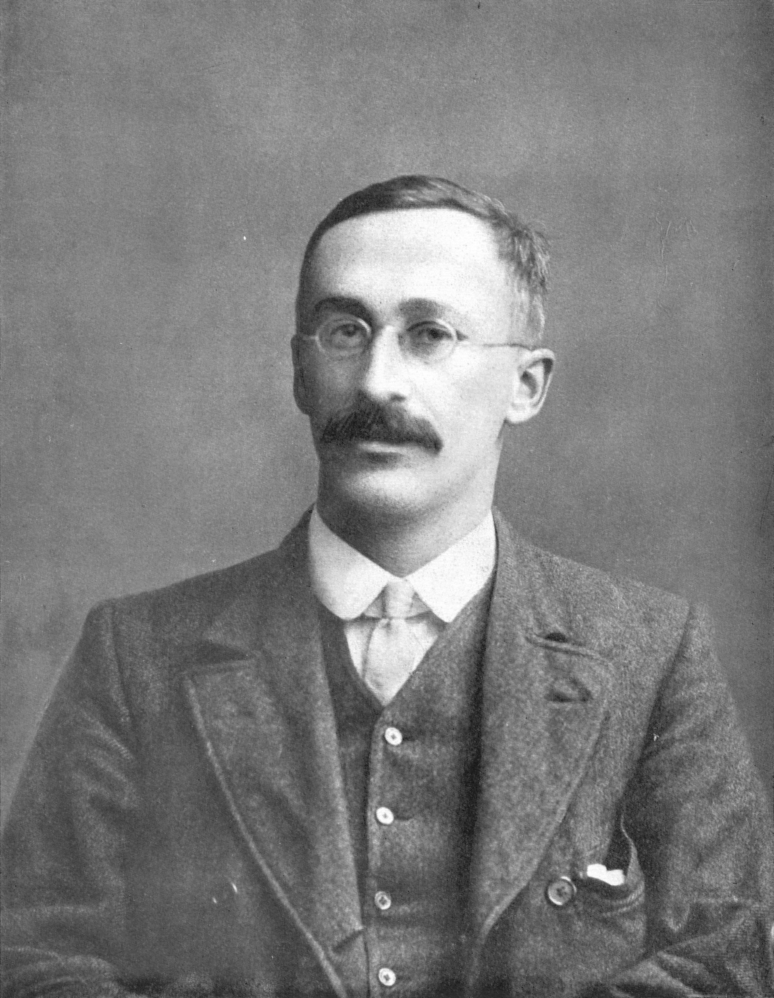
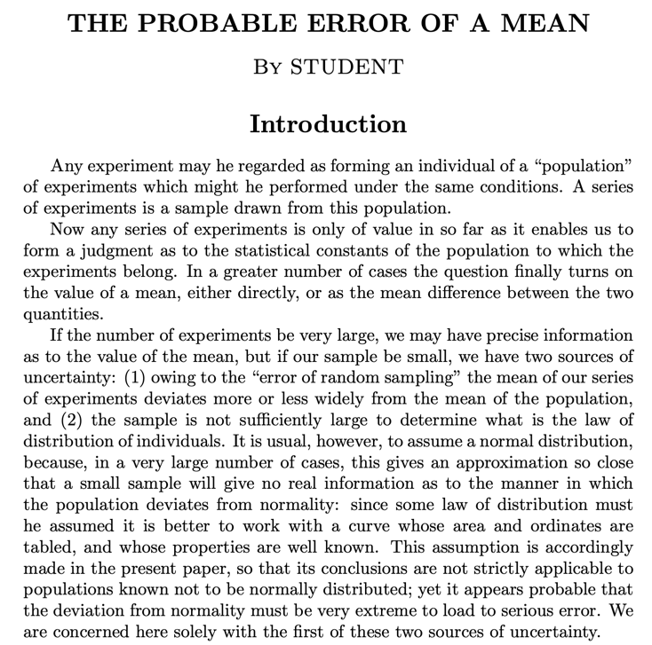
William Gosset, a.k.a. "Student". Worked at Guinness
"In his job as Head Experimental Brewer at Guinness, the self-trained Gosset developed new statistical methods. In his job as Head Experimental Brewer at Guinness, the self-trained Gosset developed new statistical methods. He published under the pseudonym 'Student' (to avoid difficulties with his employer, Guinness) in his work on optimizing barley yields. Trained with Karl Pearson. Developed most famously Student's t-distribution (originally called Student's "z") and "Student's test of statistical significance". https://en.wikipedia.org/wiki/William_Sealy_Gosset

Slide 13
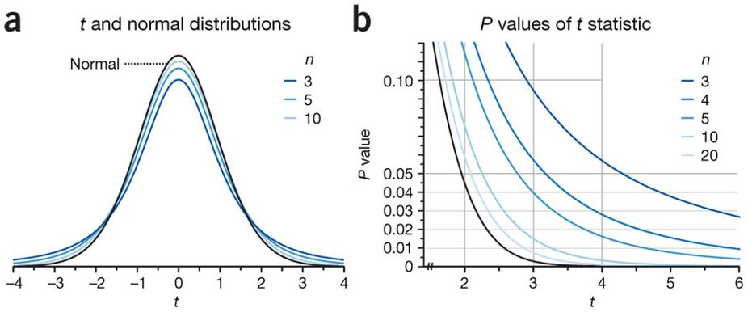
The shape of the sampling distribution is close to, but not quite normal. Instead, we use the t-distribution.
The t distribution has higher tails than the normal that take into account that most samples will underestimate the variability in a population. Better estimate of "noise"
The test statistic (t) is compared to this distribution and is thus called the t-statistic.
t = (xhat - 10.0)/sem
[1] 2.001624
https://www.nature.com/articles/nmeth.2613/figures/3

Slide 14
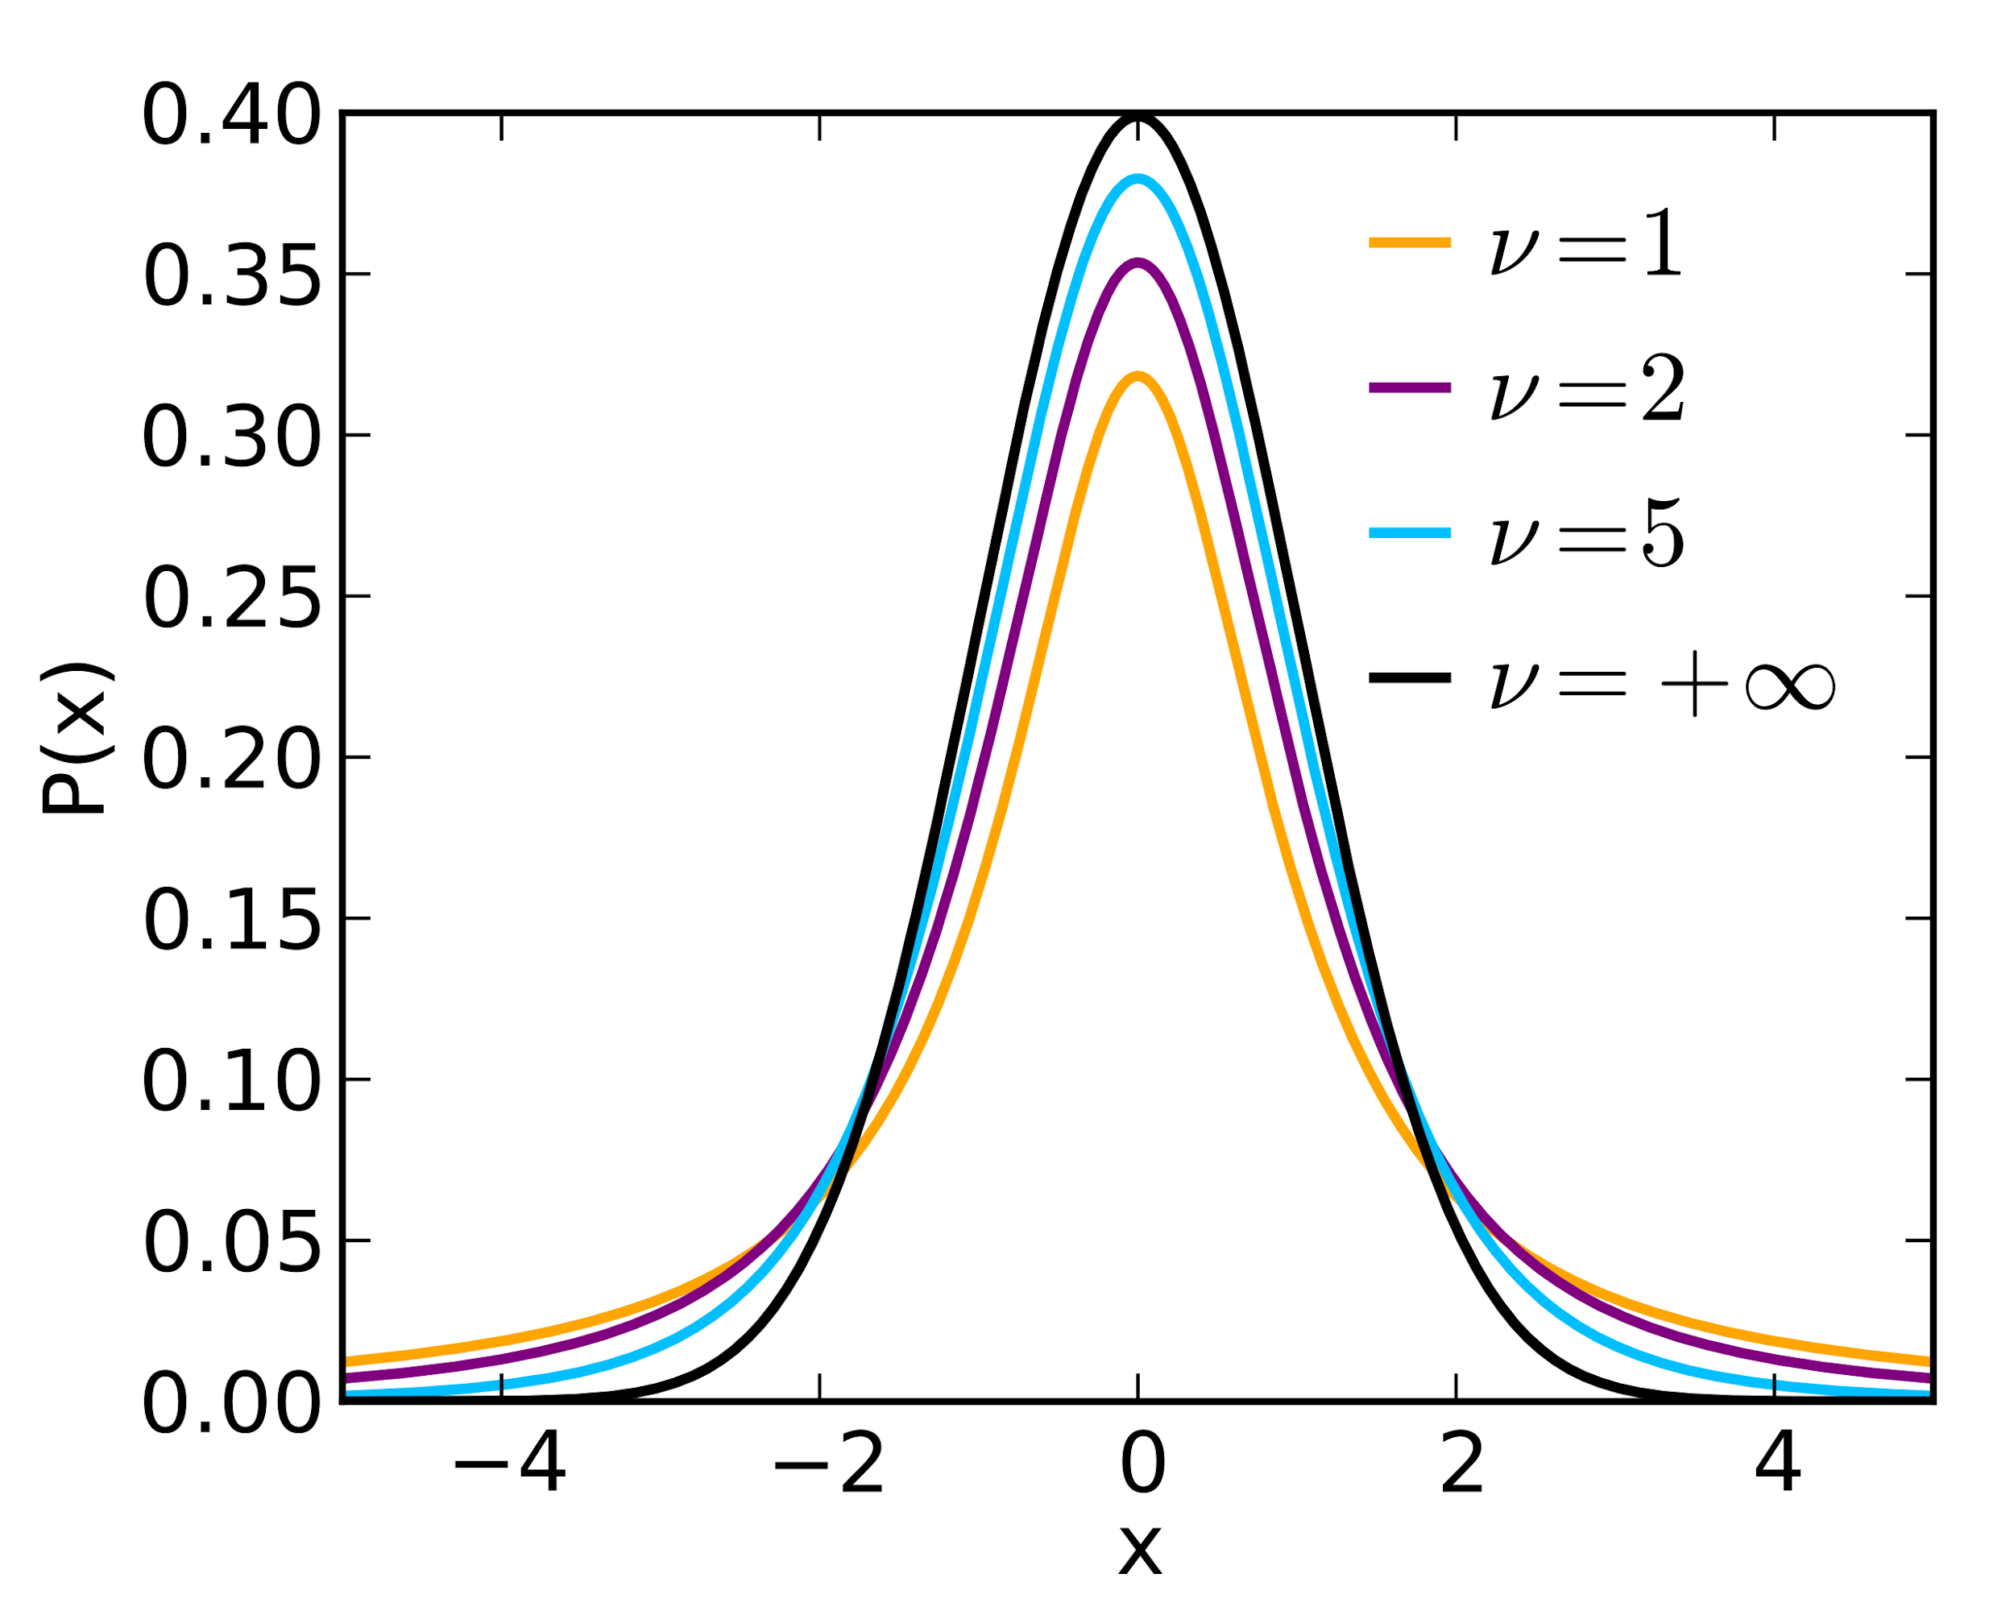
T-distribution parameters: mean, degrees of freedom (v)
The mean is assumed to be 0, unless otherwise stated. Why?
Well, the test statistic, t, is itself a random variable and it comes from the difference between the sample mean and the population mean. The null distribution of this random variable should be centered at 0 since the sample mean should be greater than the population mean just as frequently as it is less than the population mean.
(i.e., Normal)
The second parameter is the degrees of freedom (v), which is the number of variables that are free to independently vary. For the t-distribution, the degrees of freedom (v) is n-1. Why n-1? If you know sample mean, you only need n-1 of the samples to infer the nth sample (algebra). It has no "freedom" to vary.

Slide 15
"When n is small, P values derived from the t-distribution vary greatly as n changes."
https://www.nature.com/articles/nmeth.2613/figures/3

Slide 16
The test statistic is compared to the t-distribution with the correct n (and thus degrees of freedom (v = n-1)
obs_exp = c(12.0,11.5,9.5,10.5,10.8)
xhat = mean(obs_exp) # xhat
[1] 10.86
s = sd(obs_exp) # s.d.
[1] 0.9607289
sem = sd(obs_exp)/sqrt(length(obs_exp))
[1] 0.429651
t = (xhat - 10.0)/sem
[1] 2.001624
https://www.nature.com/articles/nmeth.2613/figures/3

Slide 17
Use the R function t.test() to compute a one-sample t-test!
t = (xhat - 10.0)/sem
[1] 2.001624
t.test(obs_exp, mu = 10, alternative = "two.sided")
One Sample t-test
data: obs_exp
t = 2.0016, df = 4, p-value = 0.1159
alternative hypothesis: true mean is not equal to 10
95 percent confidence interval:
9.667098 12.052902
sample estimates:
mean of x
10.86
https://www.nature.com/articles/nmeth.2613/figures/3

Slide 18
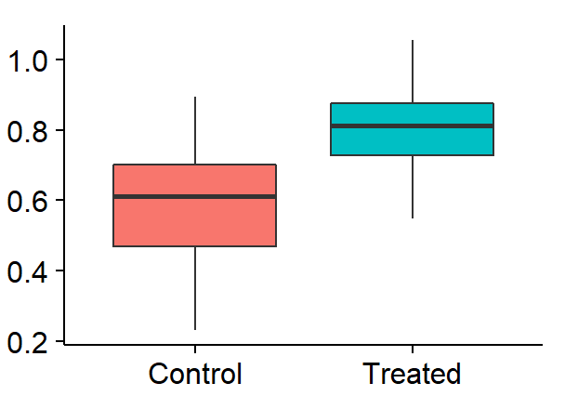
In biology, we often want to compare the means of two different samples.

Slide 19
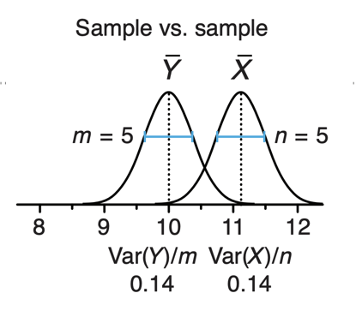
One-sample versus two-sample t-test
One sample t-test: Compare observed sample mean to reference value while accounting for uncertainty in the sample mean.
Two sample t-test: Compare two observed samples means while accounting for the combined uncertainty in the sample means.
https://www.nature.com/articles/nmeth.2613/figures/3

Slide 20
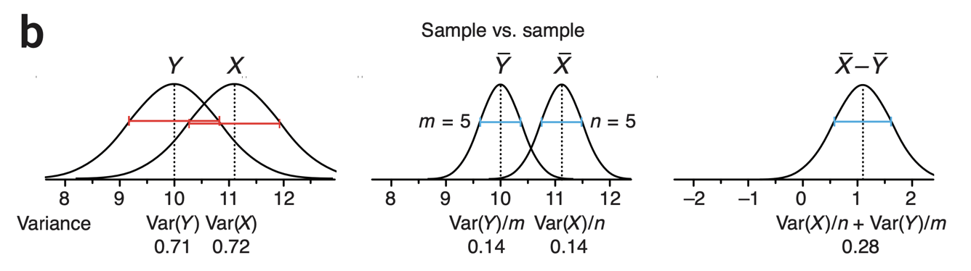
Two-sample t-test
Start with the variance of the two conditions, X (untreated) and Y (treated)
Compute the mean of each condition and adjust the variance by the sample size to assess how uncertain the variance for each condition is.
The test statistic (t) now reflects the difference of the means (approximately 1) with respect to the "pooled variance" of the two conditions

Slide 21
Let's work through an example. Compare mouse fed different diets. Modified from Love and Irizarry.
# read in weight data from mice fed two different diets.
dat = read.csv("https://raw.githubusercontent.com/genomicsclass/dagdata/master/inst/extdata/femaleMiceWeights.csv")
# peek
head(dat, n=3)
Diet Bodyweight
1 chow 21.51
2 chow 28.14
3 chow 24.04
http://genomicsclass.github.io/book/pages/clt_and_t-distribution.html, http://genomicsclass.github.io/book/pages/t-tests_in_practice.html

Slide 22
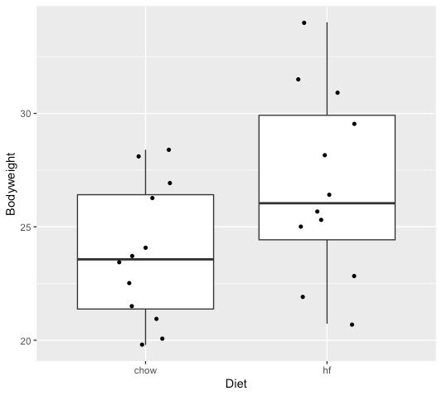
Plot the female mice fed different diets.
# read in weight data from mice fed two different diets.
dat = read.csv("https://raw.githubusercontent.com/genomicsclass/dagdata/master/inst/extdata/femaleMiceWeights.csv")
# peek
head(dat, n=3)
Diet Bodyweight
1 chow 21.51
2 chow 28.14
3 chow 24.04
# bring in useful libraries
library(dplyr)
library(ggplot2)
# box plot the weights of the control and
# high fat female mice
dat %>% ggplot(aes(x=Diet, y=Bodyweight)) +
geom_boxplot() +
geom_jitter(shape=16, position=position_jitter(0.2))
http://genomicsclass.github.io/book/pages/clt_and_t-distribution.html, http://genomicsclass.github.io/book/pages/t-tests_in_practice.html

Slide 23
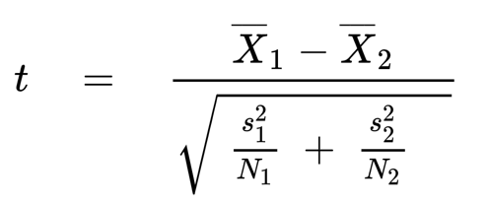
Welch's two-sample t-test (unequal variances)
The test statistic (t) for one sample is a measure of signal versus noise
"signal"
"Noise" (s.e.m.)
Reminder: standard deviation is the square root of the variance
Same goes for the two-sample test, but we must account for "pooled" noise.
"signal"
"Noise" pooled
http://genomicsclass.github.io/book/pages/clt_and_t-distribution.html, http://genomicsclass.github.io/book/pages/t-tests_in_practice.html

Slide 24
Welch's two-sample t-test (unequal variances)
"signal"
"Noise" pooled
# subset the two groups
control = dat %>% filter(Diet=="chow")
highfat = dat %>% filter(Diet=="hf")
http://genomicsclass.github.io/book/pages/clt_and_t-distribution.html, http://genomicsclass.github.io/book/pages/t-tests_in_practice.html

Slide 25
Welch's two-sample t-test (unequal variances)
"signal"
"Noise" pooled
# subset the two groups
control = dat %>% filter(Diet=="chow")
highfat = dat %>% filter(Diet=="hf")
# compute the difference of means. The numerator of t
diff_of_means = mean(highfat$Bodyweight) - mean(control$Bodyweight)
# [1] 2.375517
# theory tells us that the variance of the difference of two random variables is the sum of its variances, so we compute the variance and take the square root
pooled_se_noise <- sqrt(var(highfat$Bodyweight)/nrow(highfat) +
var(control$Bodyweight)/nrow(control))
http://genomicsclass.github.io/book/pages/clt_and_t-distribution.html, http://genomicsclass.github.io/book/pages/t-tests_in_practice.html

Slide 26
Welch's two-sample t-test (unequal variances)
"signal"
"Noise" pooled
# subset the two groups
control = dat %>% filter(Diet=="chow")
highfat = dat %>% filter(Diet=="hf")
# compute the difference of means. The numerator of t
diff_of_means = mean(highfat$Bodyweight) - mean(control$Bodyweight)
# [1] 2.375517
# theory tells us that the variance of the difference of two random variables is the sum of its variances, so we compute the variance and take the square root
pooled_se_noise <- sqrt(var(highfat$Bodyweight)/nrow(highfat) +
var(control$Bodyweight)/nrow(control))
# compute tstat
tstat = diff_of_means / pooled_se_noise
http://genomicsclass.github.io/book/pages/clt_and_t-distribution.html, http://genomicsclass.github.io/book/pages/t-tests_in_practice.html

Slide 27
Welch's two-sample t-test (unequal variances)
?
# subset the two groups
control = dat %>% filter(Diet=="chow")
highfat = dat %>% filter(Diet=="hf")
# compute the difference of means. The numerator of t
diff_of_means = mean(highfat$Bodyweight) - mean(control$Bodyweight)
# [1] 2.375517
# theory tells us that the variance of the difference of two random variables is the sum of its variances, so we compute the variance and take the square root
pooled_se_noise <- sqrt(var(highfat$Bodyweight)/nrow(highfat) +
var(control$Bodyweight)/nrow(control))
# compute tstat
tstat = diff_of_means / pooled_se_noise
#[1] 2.055174
http://genomicsclass.github.io/book/pages/clt_and_t-distribution.html, http://genomicsclass.github.io/book/pages/t-tests_in_practice.html

Slide 28
Welch's two-sample t-test (unequal variances)
"signal"
"Noise" pooled
# compute the two sample t-test
t.test(highfat$Bodyweight, control$Bodyweight)
Welch Two Sample t-test
data: highfat$Bodyweight and control$Bodyweight
t = 2.0552, df = 20.236, p-value = 0.053
alternative hypothesis: true difference in means is not equal to 0
95 percent confidence interval:
-0.04296563 6.08463229
sample estimates:
mean of x mean of y
26.83417 23.81333
Here, the degrees of freedom is close to but not quite N-1 + M-1. Instead it is a more complicated "pooled" degrees of freedom. Read this for more info.
http://genomicsclass.github.io/book/pages/clt_and_t-distribution.html, http://genomicsclass.github.io/book/pages/t-tests_in_practice.html

Slide 29
What could be done to increase confidence in rejecting the null hypothesis?
# compute the two sample t-test
t.test(highfat$Bodyweight, control$Bodyweight)
Welch Two Sample t-test
data: highfat$Bodyweight and control$Bodyweight
t = 2.0552, df = 20.236, p-value = 0.053
alternative hypothesis: true difference in means is not equal to 0
95 percent confidence interval:
-0.04296563 6.08463229
sample estimates:
mean of x mean of y
26.83417 23.81333
http://genomicsclass.github.io/book/pages/clt_and_t-distribution.html, http://genomicsclass.github.io/book/pages/t-tests_in_practice.html

Slide 30
If we add more data supportive of alt. hypothesis, the t-statistic and degrees of freedom lead to p-value < 0.05
# add two new data points that support alt. Hypothesis
highfat = rbind(highfat, list("hf", as.numeric(30.22)))
control = rbind(control, list("chow", as.numeric(24.23)))
# compute the two sample t-test
t.test(highfat$Bodyweight, control$Bodyweight)
Welch Two Sample t-test
data: highfat$Bodyweight and control$Bodyweight
t = 2.3591, df = 21.774, p-value = 0.02771
alternative hypothesis: true difference in means is not equal to 0
95 percent confidence interval:
0.3911423 6.1073193
sample estimates:
mean of x mean of y
27.09462 23.84538
http://genomicsclass.github.io/book/pages/clt_and_t-distribution.html, http://genomicsclass.github.io/book/pages/t-tests_in_practice.html

Slide 31
Analysis of Variance (ANOVA) is essentially the t-test for more than two groups.

